Slide 1
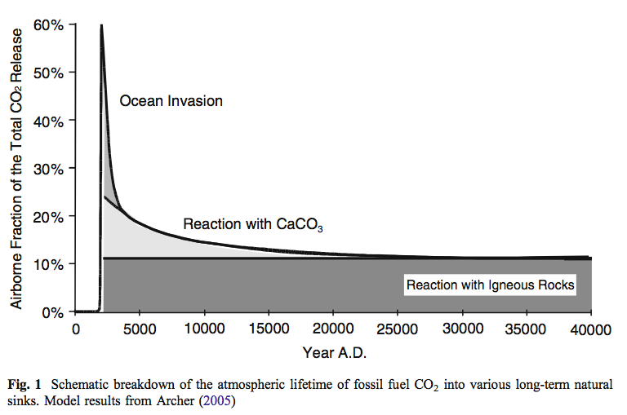
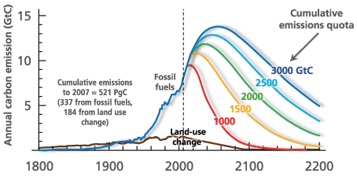
Not all the atmospheric CO₂ can be removed by nature
20% of what is emitted today will still be in the air in 1000 years.
Notes:
http://www.igbp.net/news/features/features/havewereachedpeakco2.5.1b8ae20512db692f2a680003465.html

